Slide 1
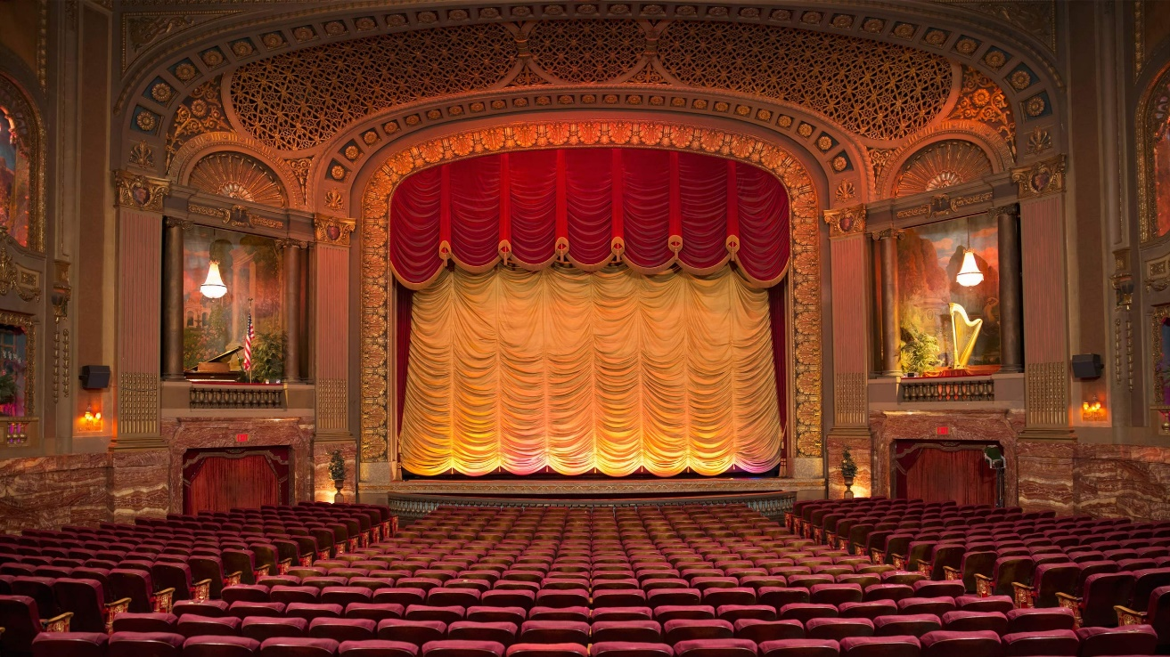
ENCHANTING PRODUCTIONS

Slide 2

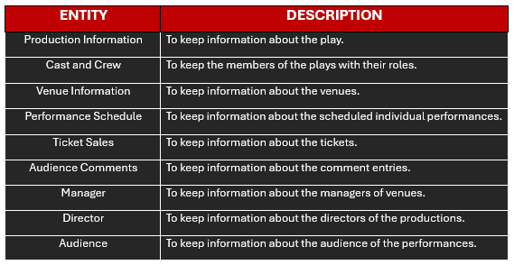

Slide 3
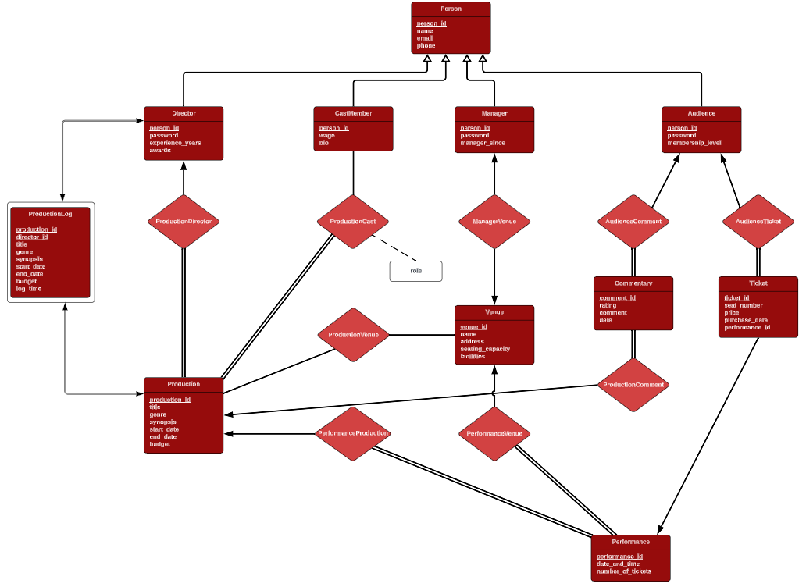
THE ER DIAGRAM

Slide 4
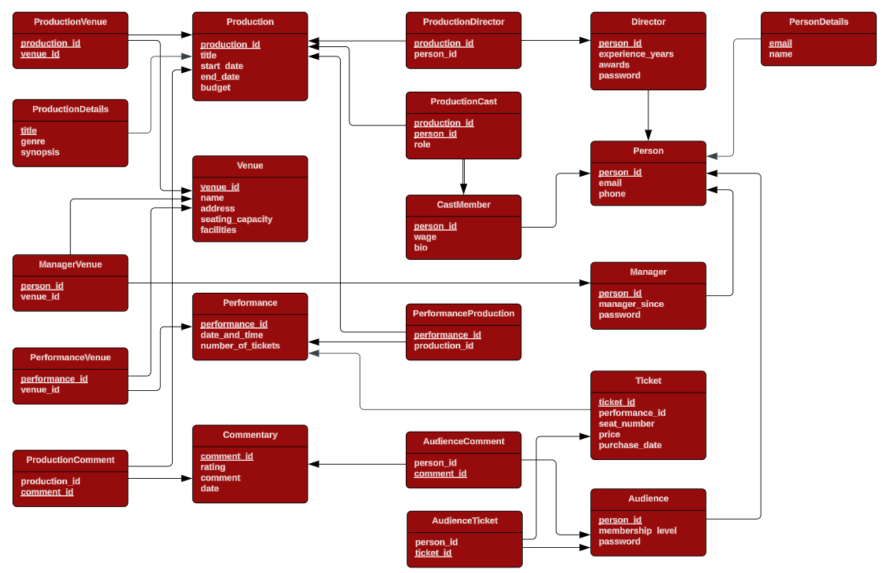
DATABASE STRUCTURE

Slide 5

TRIGGERS:
BEFORE INSERT TICKET
UPDATE MEMBERSHIP LEVEL
HANDLE ZERO TICKETS
CONFLICTS
LOG PRODUCTION CREATION
TRANSACTIONS:
INSERTIONS

Slide 6
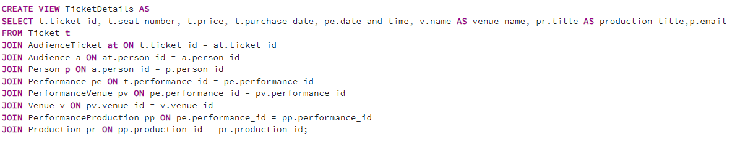
VIEWS

Slide 7
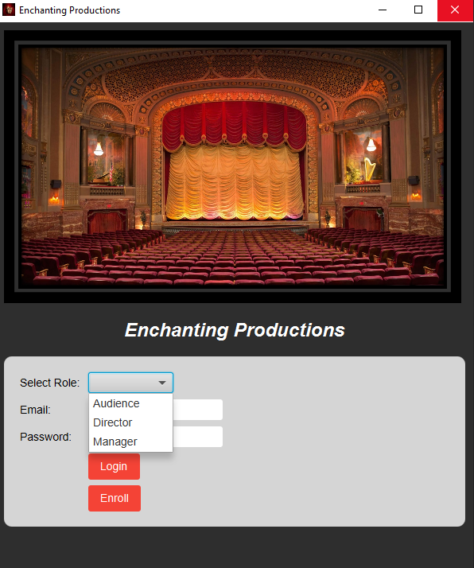
ROLES

Slide 8

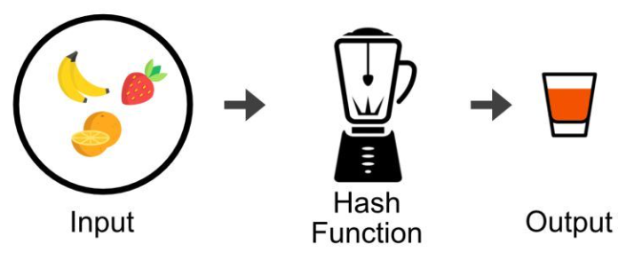
WHAT ELSE?

Slide 9


THANKS FOR LISTENING
MERT GÜRŞİMŞİR

